Slide 1
Secure data hiding in images using steganography
CAPSTONE PROJECT
Presented By: PRATIK PRADEEP BHAGAT.
Student Name : PRATIK PRADEEP BHAGAT.
College Name & Department : PROF. RAM MEGHE COLLEGE OF ENGINEERING AND MANAGEMENT.

Slide 2
OUTLINE
Problem Statement
Technology used
Wow factor
End users
Result
Conclusion
Git-hub Link
Future scope

Slide 3
Problem Statement
Develop a program that implements image steganography to securely hide textual data within a digital image. The program should allow a user to input a text message and a cover image. It should then embed the text message into the image using a suitable steganographic algorithm (e.g., LSB, DCT, etc.). The program should also provide functionality to extract the hidden text from the stego-image. The program should consider factors such as imperceptibility of the hidden data, capacity of the steganographic method, and robustness against common image manipulations. Optionally, the program can include features like encryption of the hidden message before embedding and error detection/correction mechanisms.

Slide 4
Technology used
VS Code (Visual Studio code)
Python
OpenCV (Cv2)
Numpy
Steganography
Windows OS
File System Operation
String
At least 4GB Ram

Slide 5
Wow factors
Real-world Applications:
Secure communication: Highlight the project's potential for secure communication in sensitive domains, such as journalism, whistleblowing, or intelligence.
Data protection: Emphasize the project's role in protecting sensitive data from unauthorized access or theft.
Digital watermarking: Showcase the project's ability to embed digital watermarks for copyright protection or authentication purposes.
Enhanced Security:
Multi-layered encryption: Combine steganography with robust encryption algorithms (like AES-256) to add multiple layers of security to the hidden data.
Adaptive key generation: Implement a system where the stego-key (used for embedding and extracting) is dynamically generated based on image features or other contextual factors, making it harder to guess.
Steganalysis resistance: Employ techniques that make the stego-image (image with hidden data) resistant to detection by steganalysis tools. This could involve using advanced embedding algorithms or manipulating image characteristics in a way that doesn't leave detectable patterns.

Slide 6
End users
Organization:
Armey .
Banking Sectors.
Intelligence agencies.
Law enforcement.
Businesses.
Medical professionals.
Individuals:
Privacy – Conscious users.
Whistleblowers.
Hobbyists.
Hackers.

Slide 7

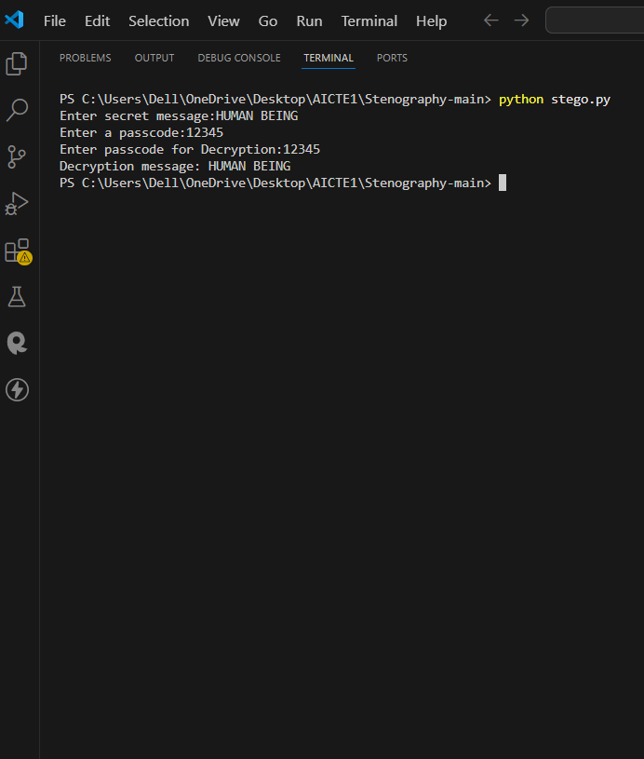
Results

Slide 8

Results

Slide 9
Conclusion
Image steganography is a powerful technique for secure data hiding, offering a covert channel for transmitting sensitive information. By embedding data within images, it provides a layer of security that makes it difficult for unauthorized individuals to detect the presence of hidden information.
However, it's important to remember that steganography is not a foolproof method. While it can be effective in hiding data, it is not immune to detection. If someone suspects that an image might contain hidden information, they may use steganalysis techniques to try and uncover it.
To further enhance the security of data hidden with steganography, it's often recommended to combine it with encryption. By encrypting the data before it is hidden, even if the steganography is detected, the underlying information remains protected.
Overall, image steganography is a valuable tool for secure data hiding, but it should be used with an understanding of its limitations and in conjunction with other security measures like encryption for optimal protection.

Slide 10
GitHub Link
https://github.com/PRATIKPRADEEPBHAGAT/Secure-Data-Hiding-in-image-using-steganography.git

Slide 11
Future scope(optional)
Enhanced Security:
Robustness against Steganalysis: Future techniques will focus on making steganographic methods more resistant to detection by steganalysis tools. This involves developing algorithms that minimize detectable changes in the image while maximizing data capacity.
Adaptive Steganography: Techniques that dynamically adjust data embedding based on image characteristics and potential steganalysis attacks will become more prevalent.
Combination with Cryptography: Integrating steganography with strong encryption methods will provide an extra layer of security, ensuring that even if the hidden data is detected, it remains unreadable without the decryption key.
Integration with Emerging Technologies:
Cloud Computing: Steganography techniques will be adapted for cloud environments to ensure secure data storage and transmission.
Internet of Things (IoT): Steganography can be used to secure data transmitted by IoT devices, protecting sensitive information from unauthorized access.
Artificial Intelligence (AI): AI can be used to develop more sophisticated steganographic methods and improve steganalysis techniques.

Slide 12
THANK YOU

